Slide 1

Energy Star Score Prediction
By,
Suhas V Londhe

Slide 2
Index
Introduction – Business problem
Data Exploration
Feature Engineering & selection
Evaluating & comparing machine learning models
Conclusions

Slide 3
Introduction – Business problem
In this report, I present findings from an exploration of the NYC benchmarking dataset which measures 60 variables related to energy use for over 11,000 buildings. Of primary interest is the Energy Star Score, which is often used as an aggregate measure of the overall efficiency of a building. The Energy Star Score is a percentile measure of a building’s energy performance calculated from self-reported energy usage.
Objectives
• Identify predictors within the dataset for the Energy Star Score
• Build Regression/Classification models that can predict the Energy Star Score of a building given the building’s energy data
• Interpret the results of the model and use the trained model to infer Energy Star Scores of new buildings
Preliminary data cleaning and exploration was completed in another Jupyer Notebook.

Slide 4
Data Exploration
As we are concerned mainly with the energy star score, the first chart to make shows the distribution of this measure across all the buildings in the dataset.
Univariate analysis – Single variable plots -
A single variable (called univariate) plot shows the distribution of a single variable such as in a histogram.

Slide 5
Data Exploration
Two variable plots

Slide 6
Feature Engineering & Selection
Remove collinear features
Highly collinear features have a significant correlation coefficent between them. For example, in our dataset, the Site EUI and Weather Norm EUI are highly correlated because they are just slightly different means of calculating the energy use intensity.
Remove collinear features in a dataframe with a correlation coefficient
greater than the threshold. Removing collinear features can help a model
to generalize and improves the interpretability of the model.
Inputs:
threshold: any features with correlations greater than this value are removed
Output:
dataframe that contains only the non-highly-collinear features
Split the data into training & testing sets

Slide 7
Feature Engineering & Selection
Establish a baseline-
It's important to establish a naive baseline before we beginning making machine learning models. If the models we build cannot outperform a naive guess then we might have to admit that machine learning is not suited for this problem. This could be because we are not using the right models, because we need more data, or because there is a simpler solution that does not require machine learning. Establishing a baseline is crucial so we do not end up building a machine learning model only to realize we can't actually solve the problem.
Performance metric : MAE
There are a number of metrics used in machine learning tasks and it can be difficult to know which one to choose. Most of the time it will depend on the particular problem and if you have a specific goal to optimize for. I like Andrew Ng's advice to use a single real-value performance metric in order to compare models because it simplifies the evaluate process. Rather than calculating multiple metrics and trying to determine how important each one is, we should use a single number. In this case, because we doing regression, the mean absolute error is an appropriate metric. This is also interpretable because it represents the average amount our estimate if off by in the same units as the target value.

Slide 8
Evaluating & comparing machine learning models
Imputing missing values
Scaling features
Below machine learning models are evaluated –
1. Linear Regression
2. Support Vector Machine Regression
3. Random Forest Regression
4. Gradient Boosting Regression
5. K-Nearest Neighbors Regression
Model Optimization

Slide 9
Evaluating & comparing machine learning models
Imputing missing values
Scaling features
Below machine learning models are evaluated –
1. Linear Regression
2. Support Vector Machine Regression
3. Random Forest Regression
4. Gradient Boosting Regression
5. K-Nearest Neighbors Regression
Model Optimization –
In machine learning, optimizing a model means finding the best set of hyperparameters for a particular problem.

Slide 10
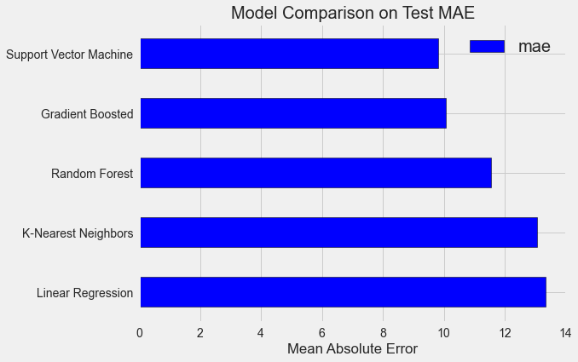
Evaluating & comparing machine learning models

Slide 11
Evaluating & comparing machine learning models
Hyperparameters -
First off, we need to understand what model hyperparameters are in contrast to model parameters :
• Model hyperparameters are best thought of as settings for a machine learning algorithm that are tuned by the data scientist before training. Examples would be the number of trees in the random forest, or the number of neighbors used in K Nearest Neighbors Regression.
• Model parameters are what the model learns during training, such as the weights in the linear regression.
Hyperparameter tuning
Evaluate the final model
Recreate the final model
Interprete the model

Slide 12
Evaluating & comparing machine learning models

Slide 13
Evaluating & comparing machine learning models

Slide 14
Conclusions
Using the given building energy data, a machine learning model can predict the Energy Star Score of a building to within 10 points.
2. The most important variables for determining the Energy Star Score are the Energy Use Intensity, Electricity Use Intensity, and the Water Use Intensity
3. Offices, residence halls, and non-refrigerated warehouses have higher energy star scores than senior care communities and hotels with scores of multi-family housing falling in between.
4. If provided with data for a new building, a trained model can accurately infer the Energy Star Score.
5. The Site Energy Use Intensity, the Electricity Intensity, and the natural gas usage are all negatively correlated with the Energy Star Score.

